Slide 1
Presentation Training for Mental Health Reform
Pat Montague,
21 October 2021.

Slide 2
Connecting
Twitter handle
@patmontague
@MHReform
Email address
pat@montaguecomms.ie
Website
www.montaguecomms.ie
www.mentalhealthreform.ie

Slide 3
Basics Reminder

Slide 4
Great Opportunity
Speaking to your public reps can be a great opportunity
Influence their policy, their party’s and the country’s
Motivate them to act
Creates bond between you and others – it’s about relationships
Gives you a sense of power and agency
Builds momentum

Slide 5
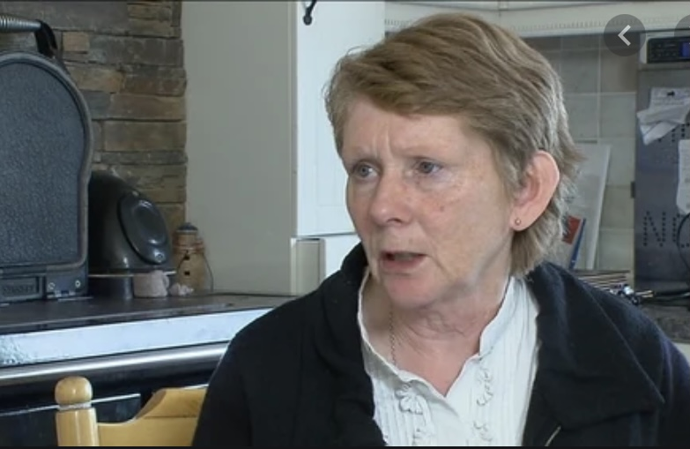
Singular Focus
People don’t remember much of what they hear – so focus & keep it simple
Concentrate on one theme – make it stick in the memory
What do you want them to take away?
Focus on what do you want people to do afterwards
Tell a great story to illustrate the theme
Spare the stats – use one killer statistic
Not for your personal vanity – why are you of interest?
Make your message stand out
Clarity, simplicity and relevance

Slide 6
Clear Message
Be clear on core message – about action to improve MH services
Add supplementary information to support it
Be wary of too much detail and loads of figures
What’s the problem?
What do you want them, their party and Government to do?
What are the benefits to the wider community
Build presentation around these points
Tell them what you are going to tell them; tell them; tell them again

Slide 7
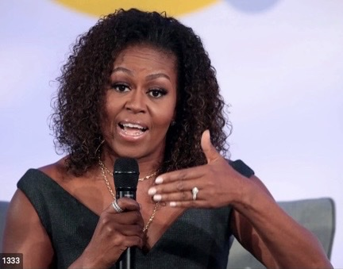
Tell a Great Story
Tell great stories to illustrate your theme
Do some research – talk to colleagues
Spare the stats – use just one killer statistic
Limit acronyms (MHR or UNCRPD for example)
This is about you and thousands of people like you
Prepare in advance
Localise and humanise!

Slide 8
Think about your Audience
Do your homework
What’s their record, what makes them tick?
Why would/should they be interested in this issue? (geography?)
Remember – they are not immersed in your work
Be prepared to explain
What’s the common ground? – build on it
Create a bridge from them to you – relate to their record, experience
Make it easy for your representative to represent you

Slide 9
Tone and Tenor
You need to be empathetic – you’re on their side
Focus on solutions – you want to make things better
However, sometimes we have to hold the line
If you’re criticising, do it with regret not relish
Better to be disappointed not angry
Talk about real people not ‘members’

Slide 10
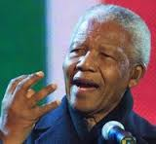
Making Presentations

Slide 11
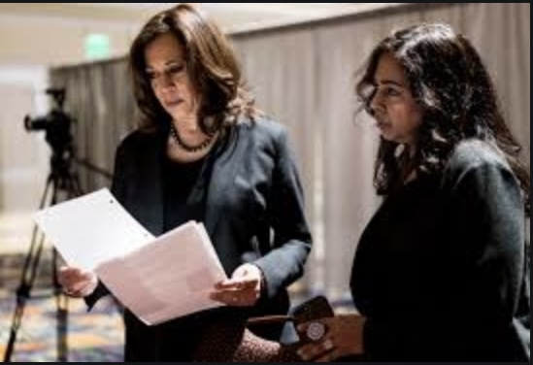
Preparing Your Presentation
Prepare an outline first –skeleton
Write your presentation out fully first – don’t edit/criticise it
Be creative!
Rewrite it to make sure it’s in line with outline
Edit, re-edit and edit again
Use a spell-check
Think about big words – replace with more commonly used

Slide 12
Using Prompts
If you can, try not to use a script – can be boring and monotonous
Too formal and unfriendly
Use notes/cards to remind you of key point
Maybe write down introduction and ending – their names, who’s on your delegation
Eases you in and helps you make a strong finish – ’and this is why we need your support’

Slide 13
Managing Your Nerves
Public reps want you to do well – you’re not their enemy!
Allow plenty of time for preparation
Be confident and engage
You don’t look as nervous as you feel
Break the ice at start – banter about match
If all else fails, don’t panic – breathe deeply
Move and speak slowly, stand or sit straight
Face your audience & look them in the eye
Smile and keep your body open
If there is a problem, ask them for help

Slide 14
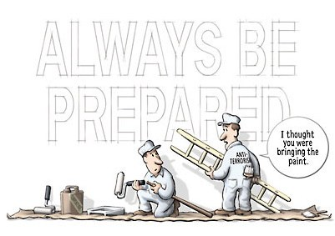
Preparing Yourself
Prepare out loud
Get a friend or colleague to give feedback – amend and improve
Time yourself – delete material if required
Meetings generally last 30 minutes to plan it out
Turn up early and suss out the venue
Have equipment set up if using Zoom
Do dry-run
You’re ready to perform!

Slide 15
Thinking About Your Content
Be clear on your key message – three stories to illustrate it
Keep thank yous to a minimum
You need to grab public rep’s attention from the start
Begin with a framing story that suggests what the topic is all about – could be your story
Think about examples to illustrate difficult to understand points
Tell anecdotes or find some good quotes online

Slide 16
Timing is Vital
Keep your input short – no more than three or four minutes
Make your input shorter than the allocated time – it will take longer to deliver in reality
Take your time at the beginning and end of your speech – slow down
Time it when you practice
Will help you prevent overruns
Need to edit, edit and edit again

Slide 17
Practice, Practice…
You need to practice your presentation out loud
How does it sound?
Is there anything missing?
What needs to be changed?
Record it on your computer or phone and listen back
Rehearse it in front of an audience – even online
Get their feedback
Amend or not

Slide 18
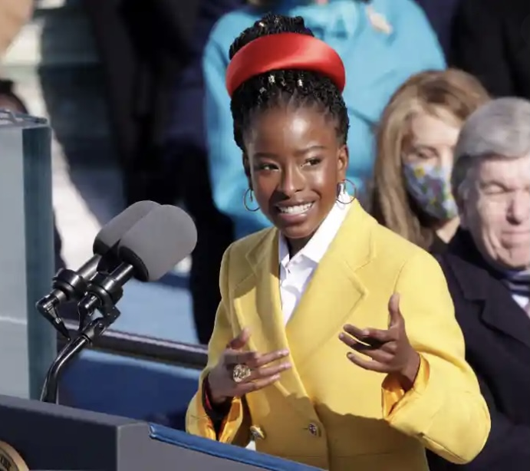
Delivering Your Presentation
Don’t read your presentation – use cards with key points
Place your cards on the lectern or table in front of you
If you forget something, take a breath and look at your cards
Stand/sit up straight and look at your audience
Hold on to the lectern/table/chair to keep you straight
Project your voice so that you can be heard clearly – head up and looking forward

Slide 19
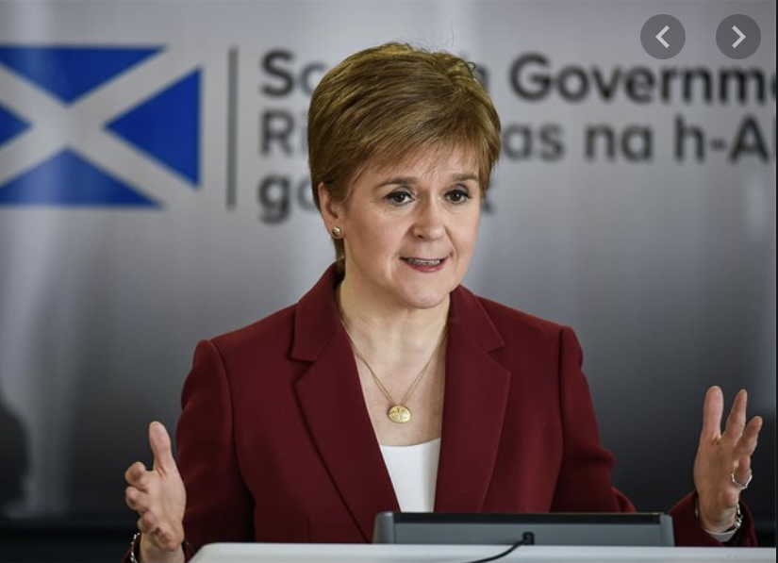
Appearance and Body Language
How you look is important – do you want them talking about clothes or presentation
Smart casual – what would impress you?
Your body language is critical for connecting with your audience
Convey enthusiasm for your topic and openness to audience
No folded arms or hands in pocket
Talk with your hands like an Italian
Don’t use aggressive gestures – only connect with already converted and alienate rest

